Slide 1
Economic Activities: Producing and Trading

Slide 2
The Production Possibilities Frontier (PPF)
Assume the following:
Only two goods can be produced in an economy: televisions and computers
The opportunity cost of one television is one computer
As more of one good is produced, the opportunity cost between the sets and computer is constant.
Can you tell me what each of these assumptions imply in terms of the shape of the graph if we plot it?

Slide 3
Definition of Production Possibilities Frontier
The PPF is a graph representing the possible combinations of two goods than an economy can produce in a certain period of time under the conditions of a given state of technology, no unemployed resources and efficient production.
So when we have various combinations of two goods that can be produced, and when we plot them and connect the lines, that gives us the PPF.

Slide 4
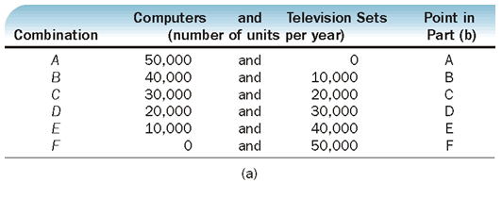
Can you Plot this?

Slide 5
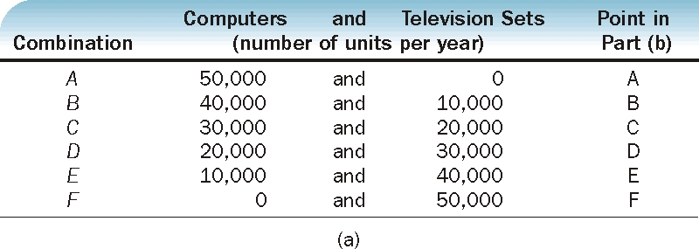
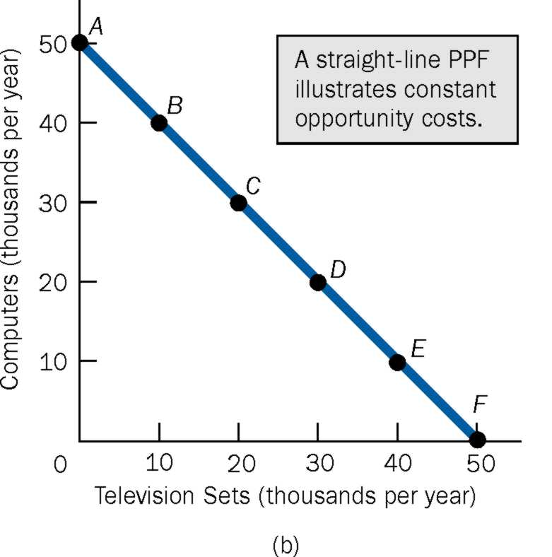
Lets look at it graphically
STRAIGHT LINE PPF = CONSTANT OPPORTUNITY COSTS

Slide 6
The Bowed out PPF: Increasing Opportunity Costs
Assume the following:
Only two goods can be produced in an economy: Computers and Television sets
As more of one good is produced, the opportunity cost between computers and television sets changes.
Again, what can we imply from these two assumptions regarding the shape of the PPF/graph if we plot it?

Slide 7
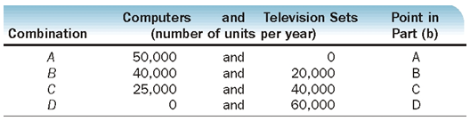
Can You Plot This?

Slide 8
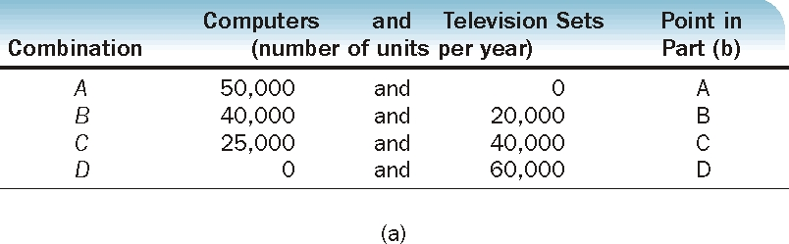
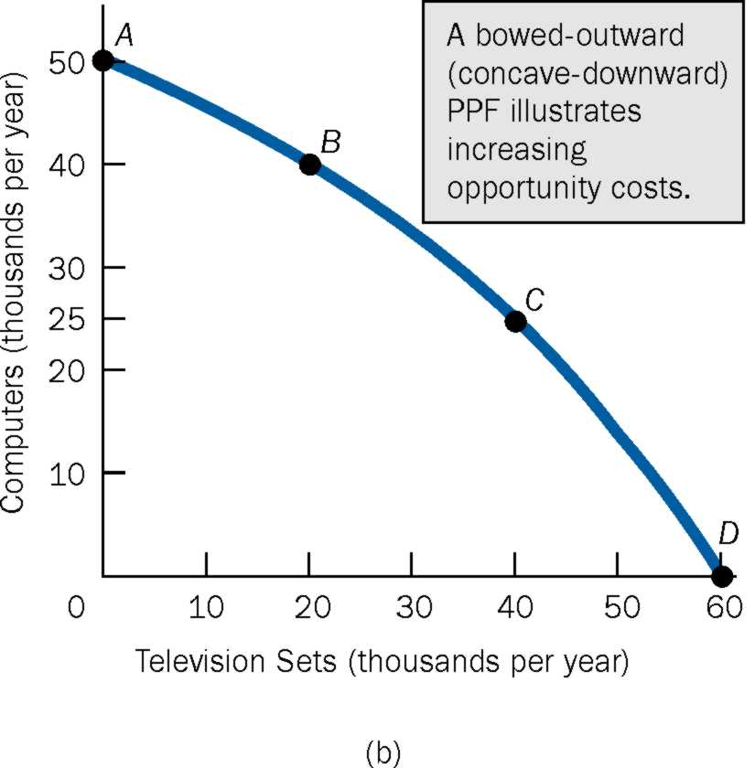
Lets look at it graphically
Bowed Out PPF = Increasing Opportunity costs

Slide 9
Law of Increasing Opportunity Costs
Law of Increasing Opportunity costs: As more of a good is produced, the opportunity costs of producing that good increases.
The answer is because people have varying capabilities.
For instance, does all of us learn our course material at the same rate? Some students can be quicker to absorb material than others.
Let’s look at the example given in the book.

Slide 10
Law of Increasing Opportunity Costs (CONT)
Assume a construction company is hiring workers to build buildings.
At first, the company will employ the most skilled workers who are productive, and can quickly (in less time) can building.
At this point, the first few buildings will be made more quickly.
What does this imply for opportunity costs of constructing the buildings?

Slide 11
Law of Increasing Opportunity Costs (CONT)
Now assume that the construction company is becoming bigger and expanding business.
To make more buildings, they need additional workers. Assuming that the company had already taken up all the skilled workers, they are now hiring workers who are less skilled at making buildings.
As a result, it takes more time to make the same buildings.
What does this imply for opportunity costs of constructing the buildings?

Slide 12
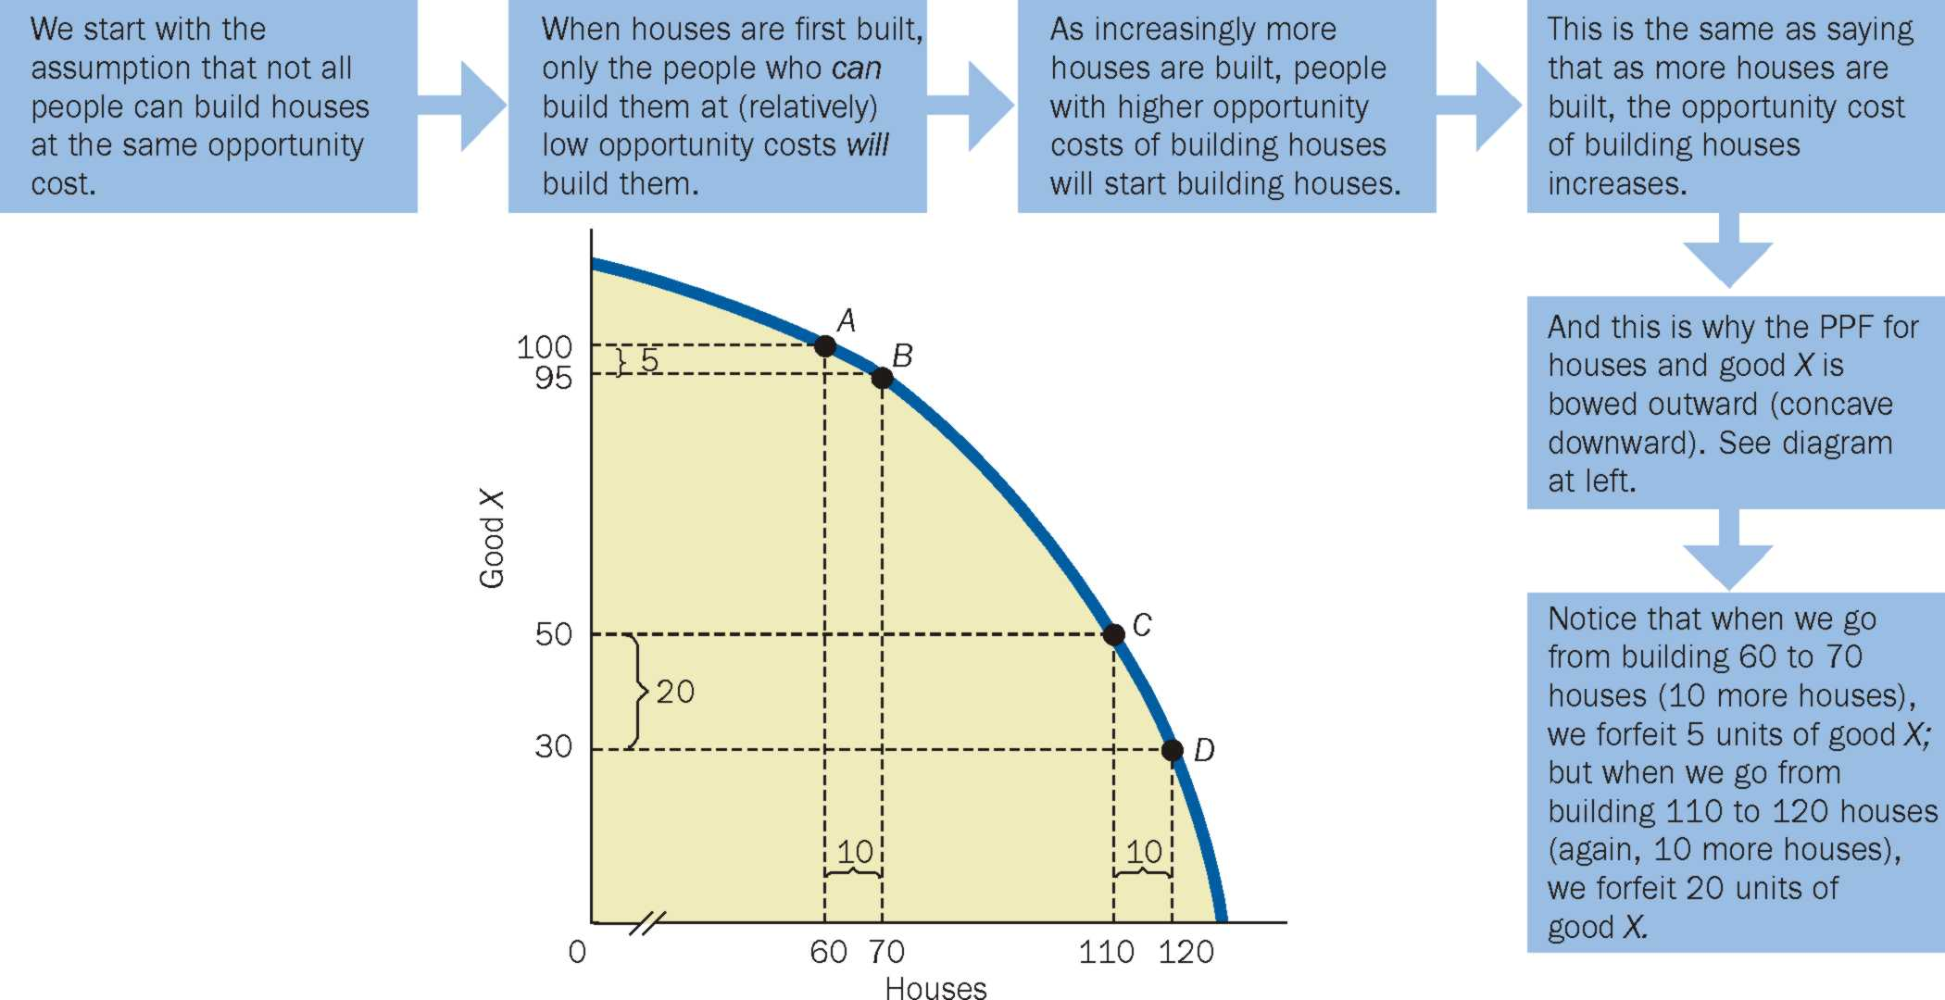
Exhibit 5 A Summary Statement about Increasing Opportunity Costs and a Production Possibilities Frontier that Is Bowed Outward (Concave Downward)

Slide 13
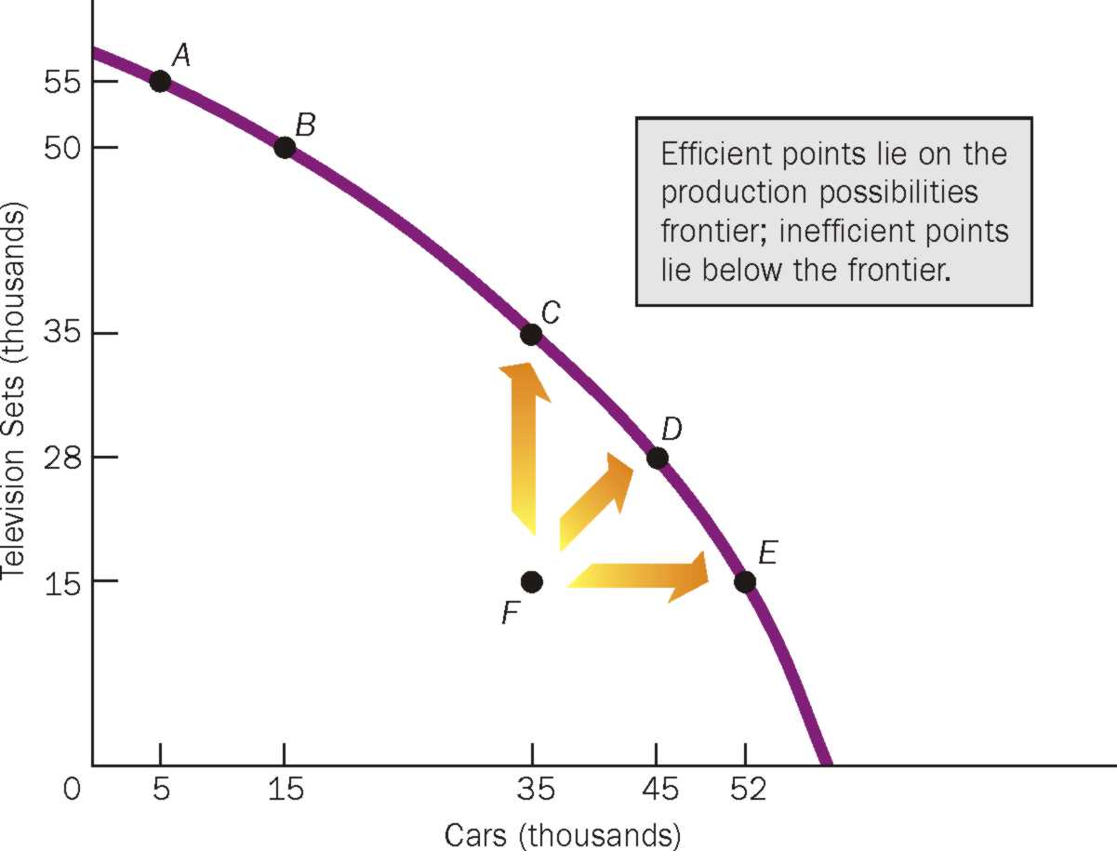
Economic Concepts within the PPF framework

Slide 14
Economic Concepts within the PPF framework
Scarcity, Choice, Opportunity Cost
Productive Efficiency: The condition where the maximum output is being produced with given resources and technology.
Productive Inefficiency: The condition where less is being produced with the given resources and technology. Productive efficiency implies that more can be produced without any less of another.
Unemployed Resources

Slide 15
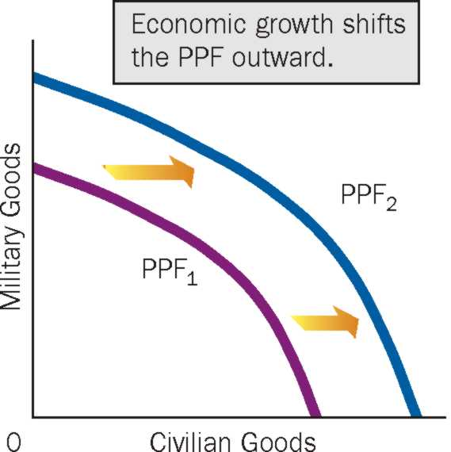
Economic Concepts within the PPF framework (CONT)
Economic Growth: Refers to the increased productive capacity of an economy.
May be due:
Increase in quantity of resources
Increase in technology (the ability to produce more with the same quantity of resources)

Slide 16
Production, Trade and Specialization
Assume we are in an economy that has no money. We are in a barter system, meaning to get one good, you need to give up another.
Now assume the following:
Two people: Elizabeth and Brian,
Two goods: Apple and Bread
Right now they are producing both apples and loaves of bread for their own consumption ➔ NO TRADE

Slide 17
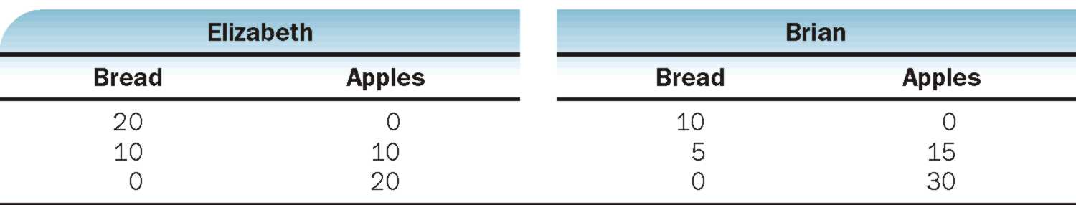
Production, Trade and Specialization
Elizabeth and Brian are producing their own apples and loaves of bread in the following numbers:
Looking at the table, do you think they should specialize and trade?
Lets look at opportunity costs!

Slide 18
Production, Trade and Specialization
In economics, you answer this question by finding who produces what at the lowest cost. This is called COMPARITIVE ADVANTAGE.
Based on comparative advantage, Elizabeth produces bread and Brian produces apples.
Are they both better off?

Slide 19
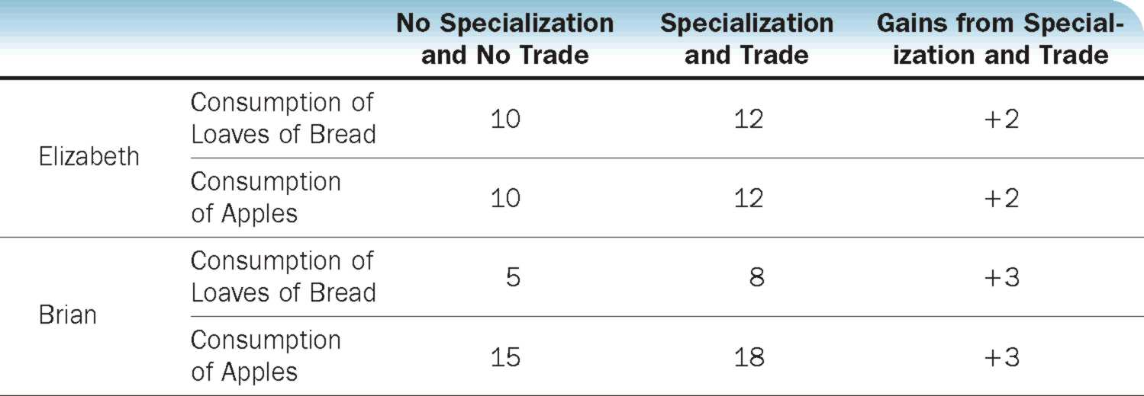
Production, Trade and Specialization

